Slide 1
A Practical Approach to Timeseries Forecasting using Python
Basic Data Manipulation in Time Series
How to Install Packages?
Basic Plotting and Data Visualization in Python
Dataset Manipulation and Slicing
Overview of Time Series Parameters
Shahzaib Hamid

Slide 2
Section Overview?
Pandas, Numpy, MatplotLib and scikit-learn are basic important libraries of python.
Pandas is used to develop and modify data frames.
Numpy is one of the most commonly used packages for scientific computing in Python.
Matplotlib is a cross-platform, data visualization and graphical plotting library for Python.
Scikit-learn (Sklearn) is the most useful and robust library for machine learning in Python.

Slide 3
Packages Installation?
Recommended Tool:
Anaconda Distribution of Python
Steps:
Visit Anaconda.com/downloads
Select Windows
Download the .exe installer
Open and run the .exe. Installer
Open the Anaconda Prompt and you are good to go
After Installation, create new environment on Anaconda
pip install Jupyter notebook
Install dependencies

Slide 4
Basic Plotting and Data Visualization in Python
There are mainly three core frameworks for data visualization in Python.
1. Basic matplotlib
2. Area Plots, Histograms, and Bar Plots
3. Pie Charts, Box Plots, Scatter Plots, and Bubble Plots

Slide 5
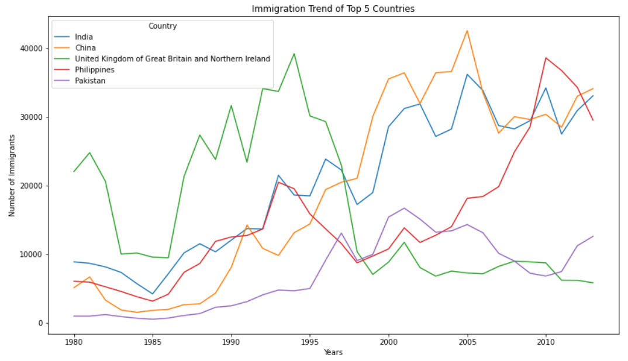

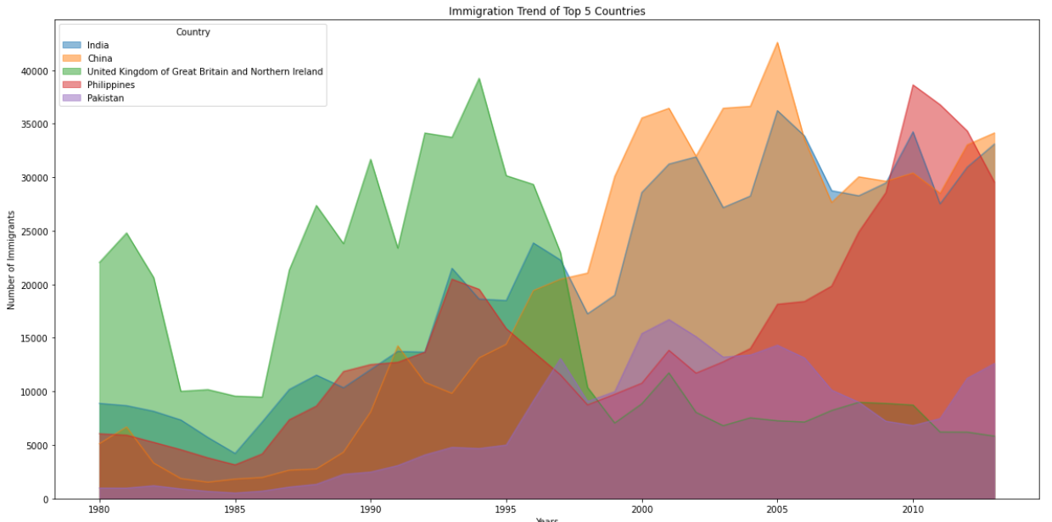
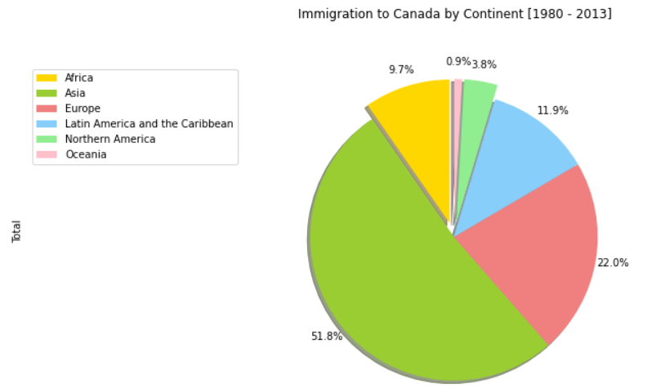
Overview of Data Visualization
Basic matplotlib
Area Plots, Histograms, and Bar Plots
Pie Charts, Box Plots

Slide 6
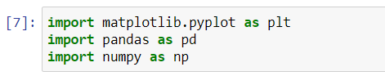

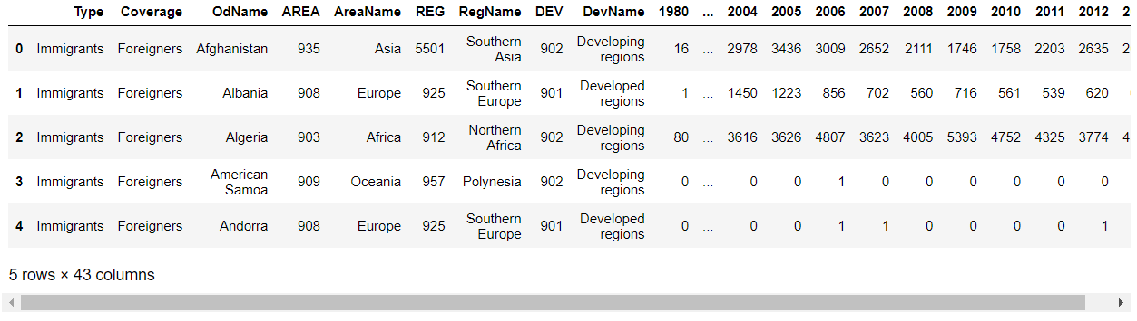

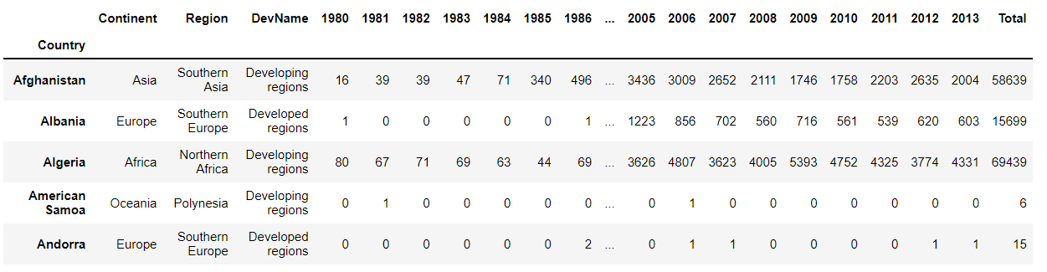

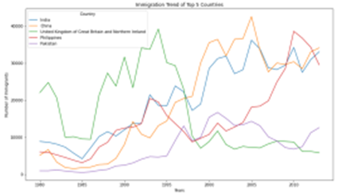
Matplotlib
Install Dependencies
Data visualization using matplotlib
Data slicing
Load Dataset

Slide 7
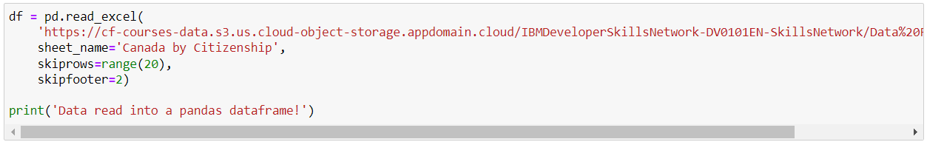
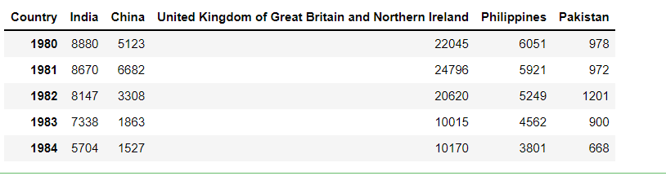
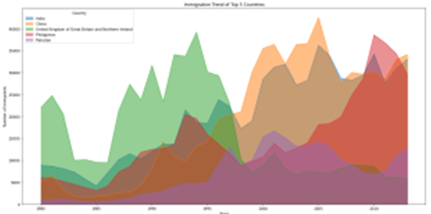
Area Plots, Histograms, and Bar Plots
Load Dataset
Data visualization of Area Plot
Data Sorting

Slide 8
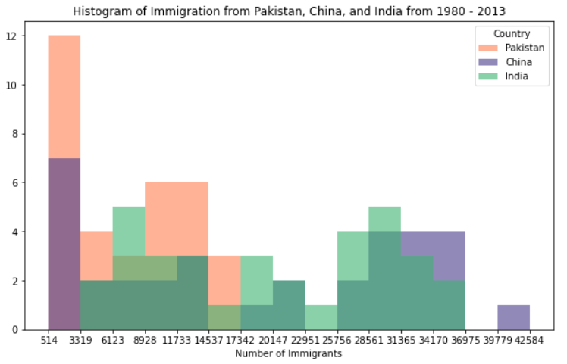


Histogram and Pie Charts
Histogram
Pie Charts

Slide 9
Overview of Time Series Parameters
MAE
RMSE
MAPE
Correlation

Slide 10
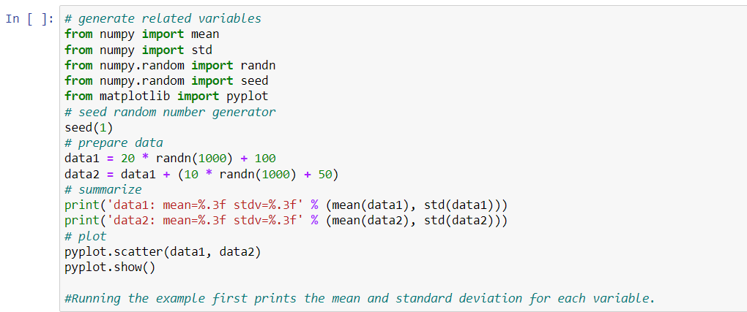
Correlation
It can be useful in data analysis and modeling to better understand the relationships between variables.
The statistical relationship between two variables is referred to as their correlation.
numpy, matplotlib

Slide 11
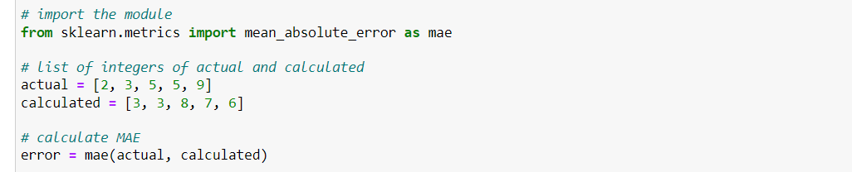
Mean Absolute Error
Mean Absolute Error calculates the average difference between the calculated values and actual values.
It is also known as scale-dependent accuracy as it calculates error in observations taken on the same scale.
It is used as evaluation metrics for regression models in machine learning.
scikit-learn

Slide 12
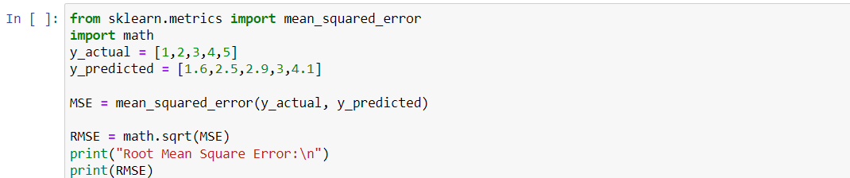
Root Mean Square Error
Root Mean Square Error, which is the square root of value obtained from Mean Square Error function.
Using RMSE, we can easily plot a difference between the estimated and actual values of a parameter of the model.
scikit-learn

Slide 13
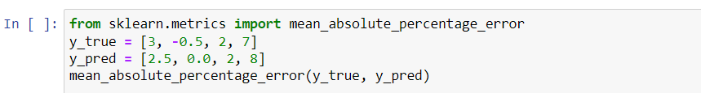
Mean Absolute Percentage Error
It is a statistical measure to define the accuracy of a machine learning algorithm on a particular dataset.
Can be considered as a loss function to define the error termed by the model evaluation.
It helps estimate the accuracy in terms of the differences in the actual v/s estimated values.
scikit-learn

